Slide 1
Community Analysis: Graphs of Top 100 Words by Frequency from Prominent Twitter Users
Alex Nazareth
Ryerson University

Slide 2

Gephi Procedure
ForceAtlas2 layout algorithm settings (run until it appears to settle)
Scaling = 10 and Gravity = 20
Dissuade Hubs = true
LinLog mode = true
Prevent Overlap = true (only briefly at the end for performance reasons)
Remaining settings left as default
Calculate modularity statistic and partition node colours
Set node size based on degree
Add node labels
Run LabelAdjust, along with some manual visual tweaks

Slide 3

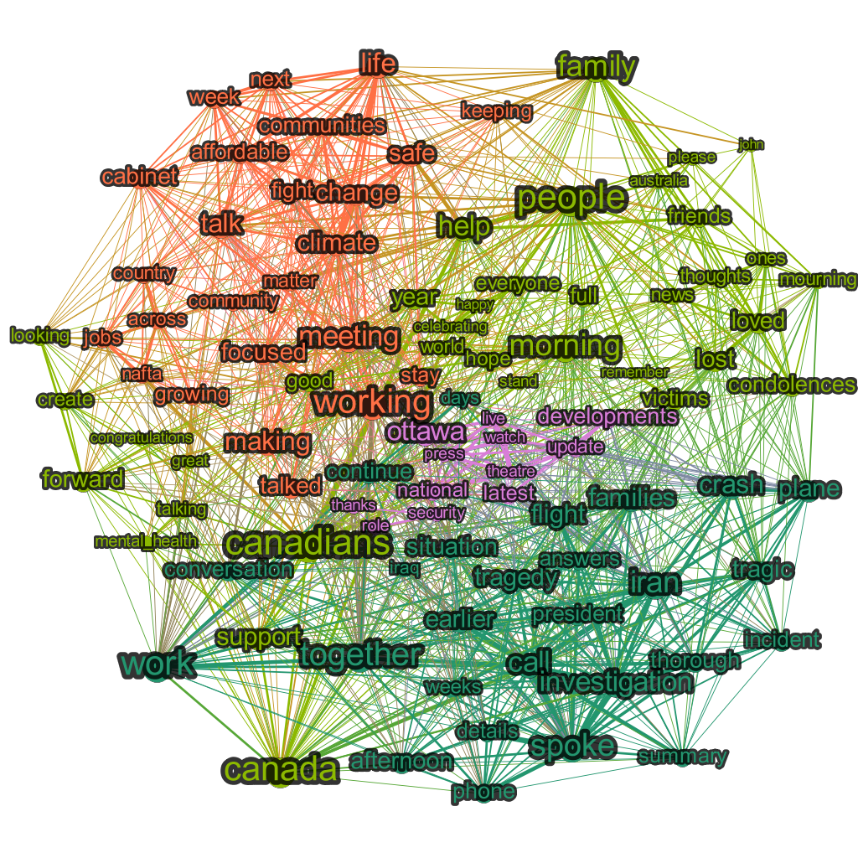
@JustinTrudeau January 2020
Potential Community Meanings
Orange
Policy
Lime green
Positive support
Dark green
Tragedies (Iran plane incident)
Investigation progress
Pink
Updates/news
National security
J
F
M
A
M
+

Slide 4
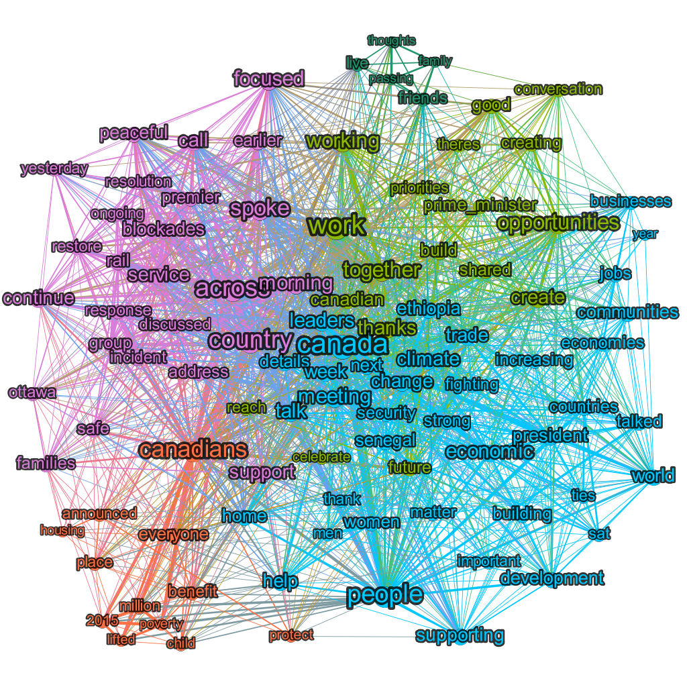
@JustinTrudeau February 2020
Potential Community Meanings
Orange
Canada Child Benefit
Campaign promise to reduce child poverty
Lime green
Policy
Dark green
Condolences for recent deaths
Blue
Visit to Ethiopia
Pink
Coastal GasLink pipeline protests
J
F
M
A
M
+

Slide 5
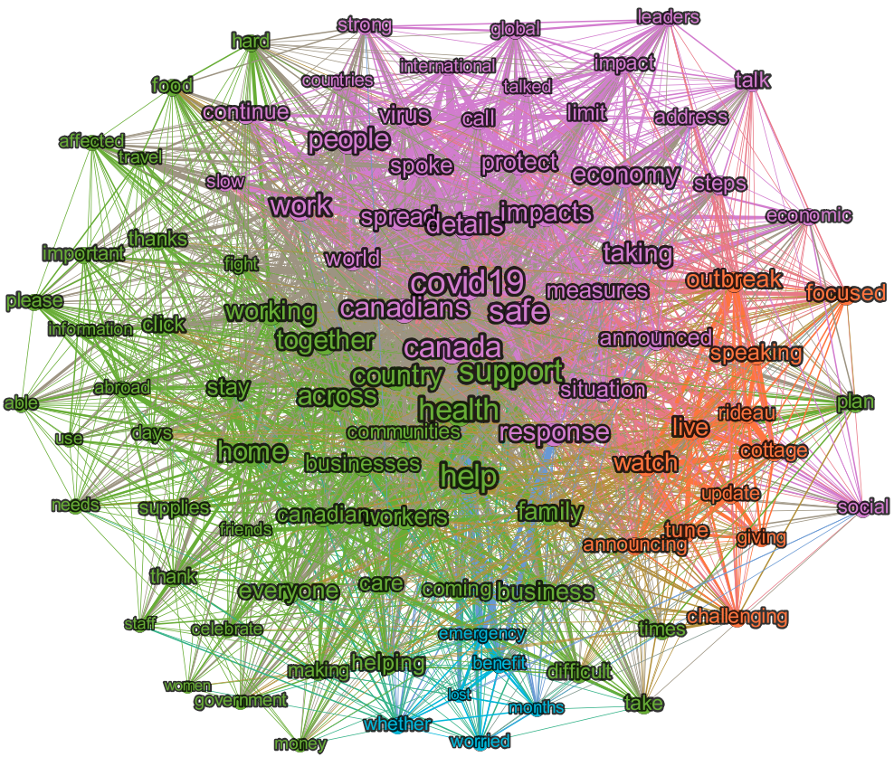
@JustinTrudeau March 2020
Potential Community Meanings
Orange
COVID updates from Rideau Cottage
Lime green
Encouragement
Blue
Lost income relief measures
Pink
COVID measures
J
F
M
A
M
+

Slide 6
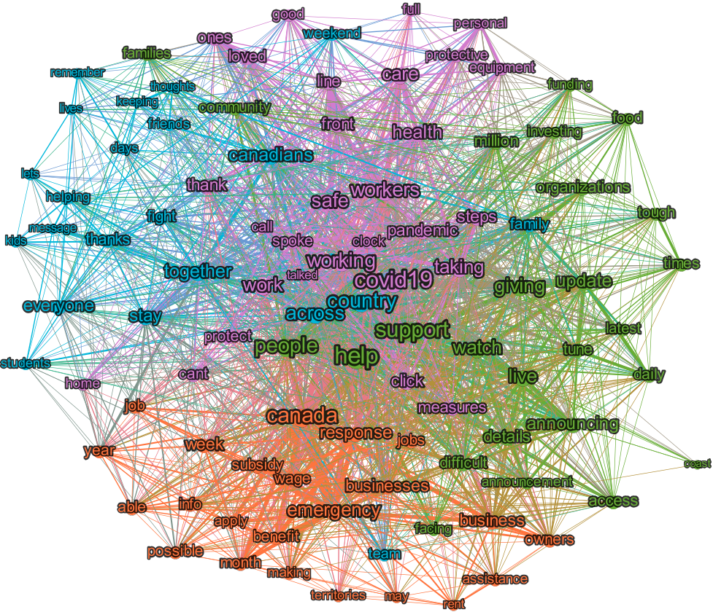
@JustinTrudeau April 2020
Potential Community Meanings
Orange
Economic relief measures (CERB etc)
Lime green
COVID morning updates
Blue
Encouragement
Pink
COVID general healthcare updates
J
F
M
A
M
+

Slide 7
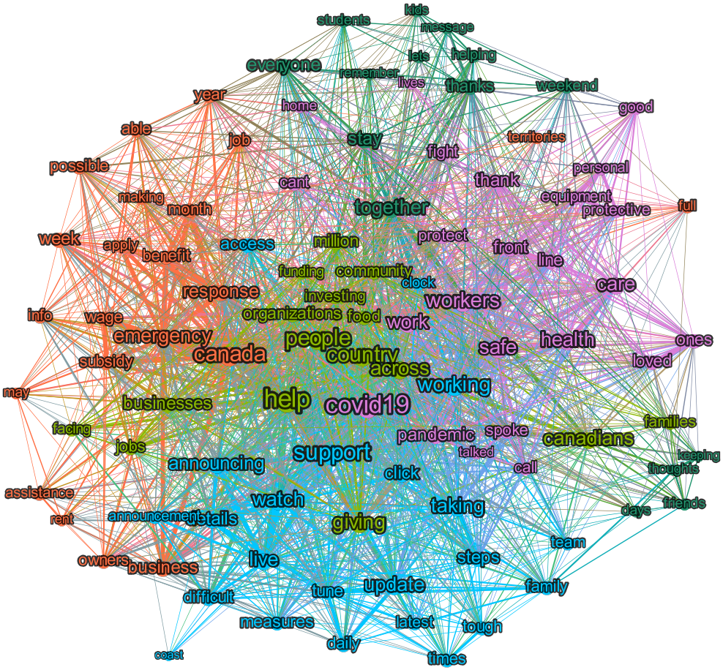
@JustinTrudeau May 2020
Potential Community Meanings
Orange
Economic relief measures (CERB etc)
Lime green
Policy
Blue
COVID morning updates
Pink
COVID general healthcare updates
J
F
M
A
M
+

Slide 8
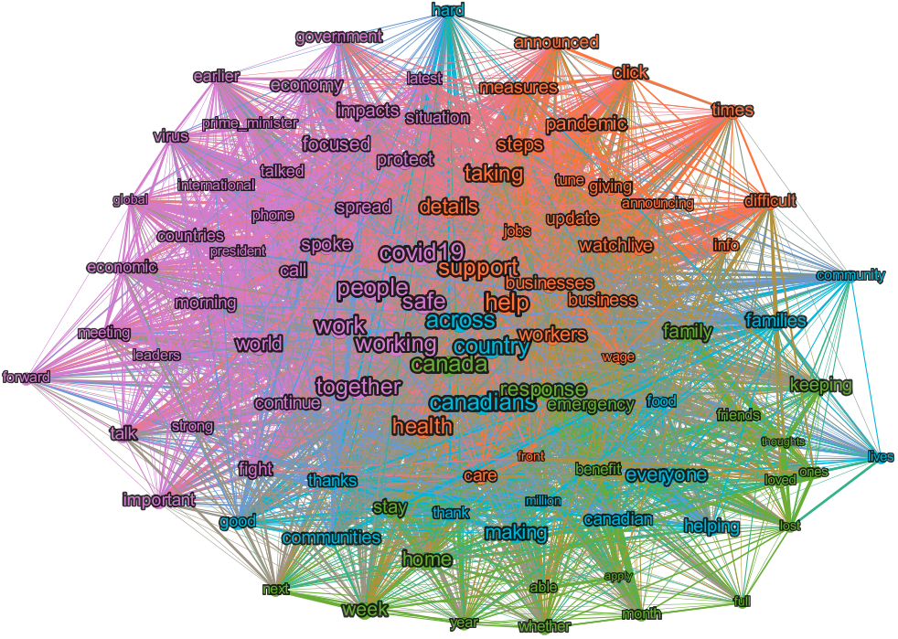
@JustinTrudeau May YTD 2020
Potential Community Meanings
Orange
COVID daily updates
Lime green
Help
Blue
Encouragement
Pink
Work he is doing
J
F
M
A
M
+

Slide 9

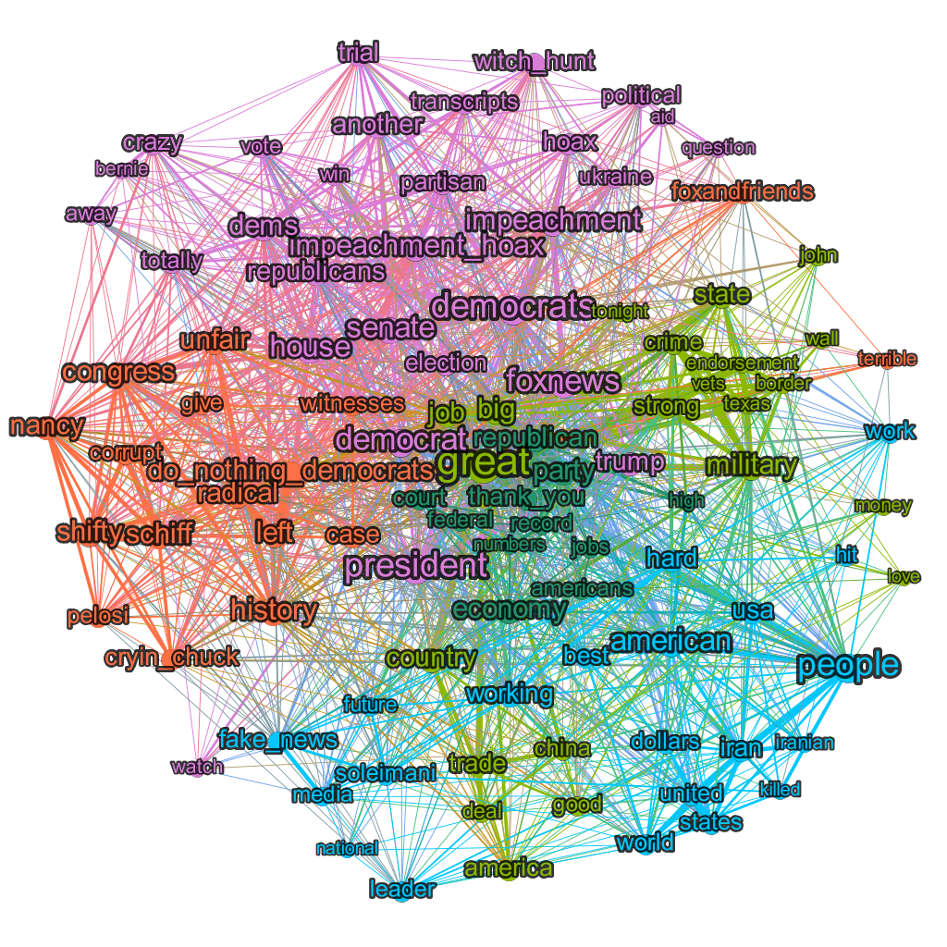
@realDonaldTrump January 2020
Potential Community Meanings
Orange
Perceived democrat scheming
Lime green
Applauding China for their transparency and success at containing COVID-19
Supporting Republican representatives
Dark green
Jobs/economy
Blue
Soleimani assassination
Pink
Impeachment
J
F
M
A
M
+

Slide 10
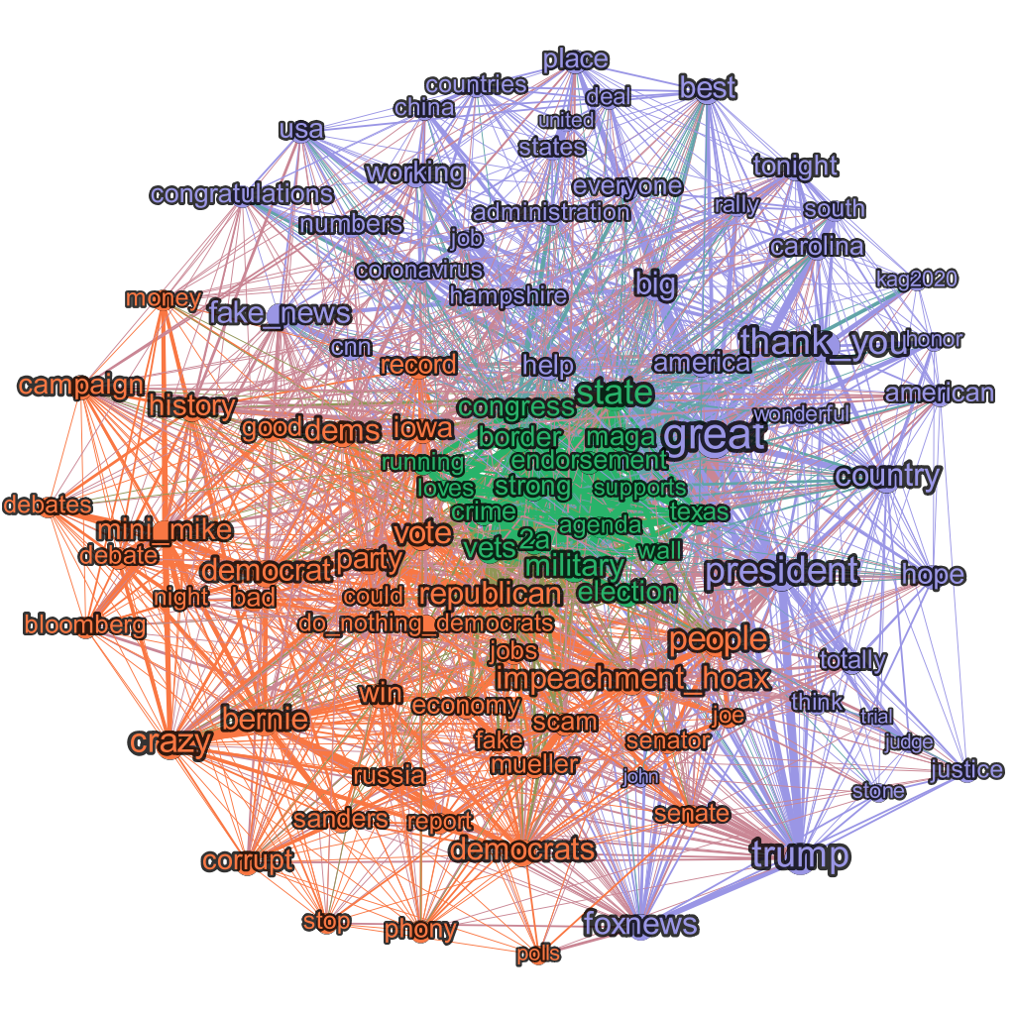
@realDonaldTrump February 2020
Potential Community Meanings
Orange
Perceived democrat scheming
Democratic primaries
Green
Strength/republican values
Lavender
Republican primaries
J
F
M
A
M
+

Slide 11
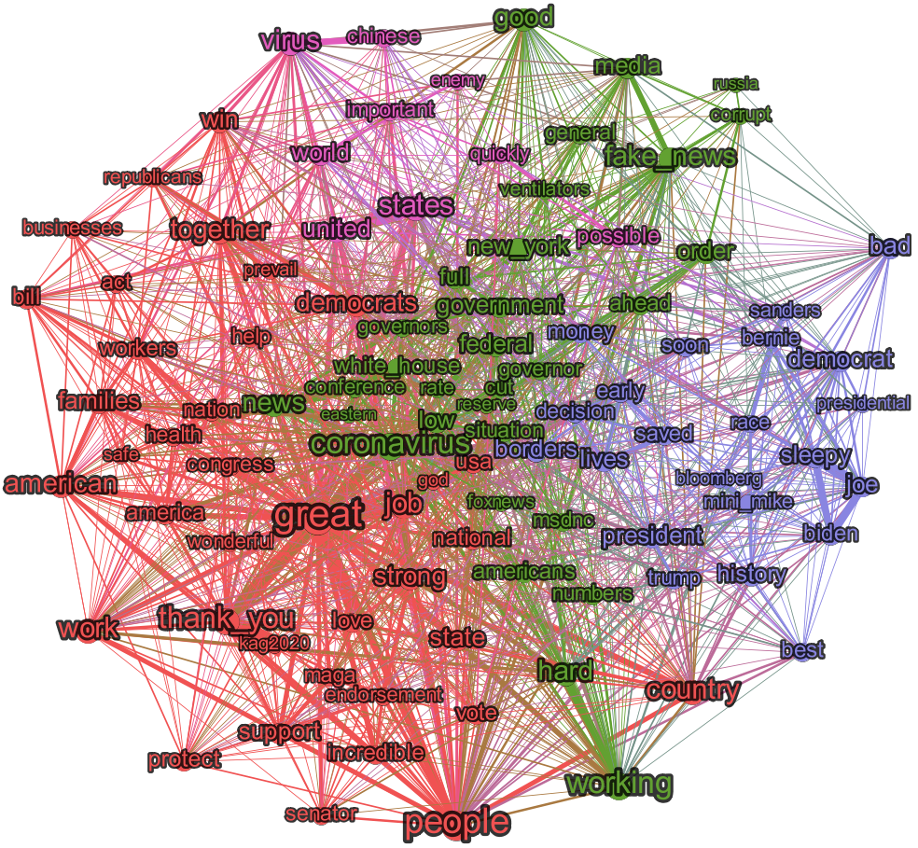
@realDonaldTrump March 2020
Potential Community Meanings
Red
Primaries
Green
COVID-19
Media
Lavender
Democrats
J
F
M
A
M
+

Slide 12
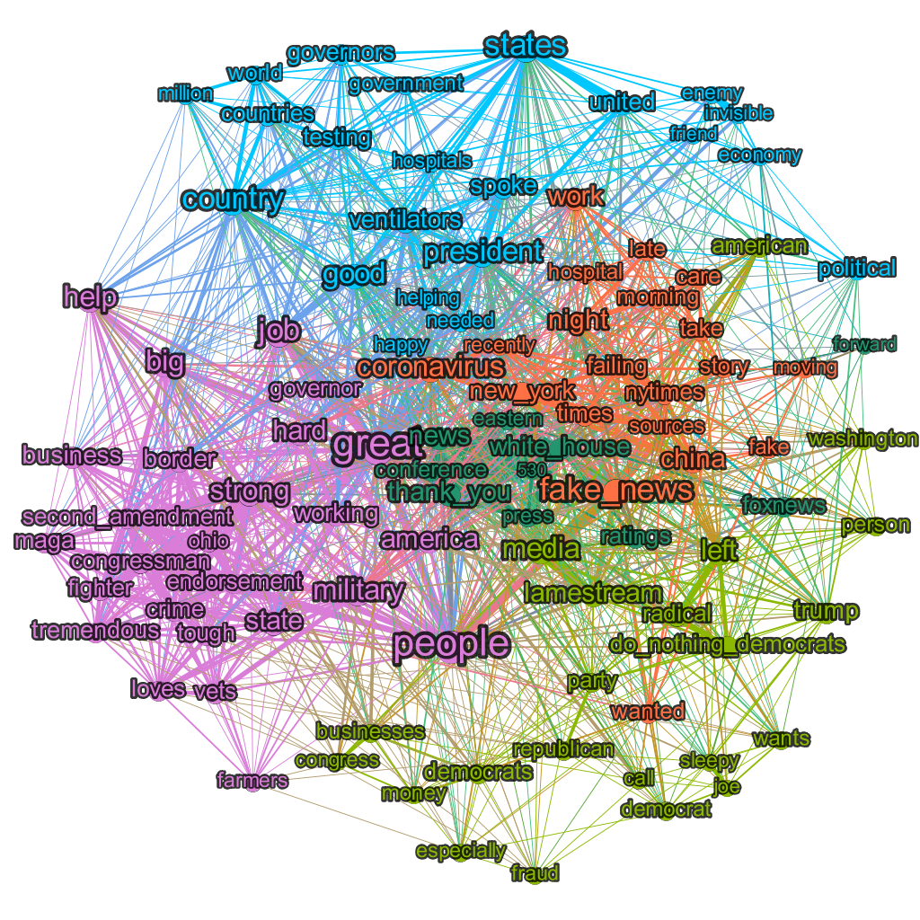
@realDonaldTrump April 2020
Potential Community Meanings
Orange
COVID-19
Media
Lime green
Democrats
Dark green
White House press conferences at 5:30
Blue
Government response to COVID-19
Pink
Republican congressional primary endorsements
J
F
M
A
M
+

Slide 13
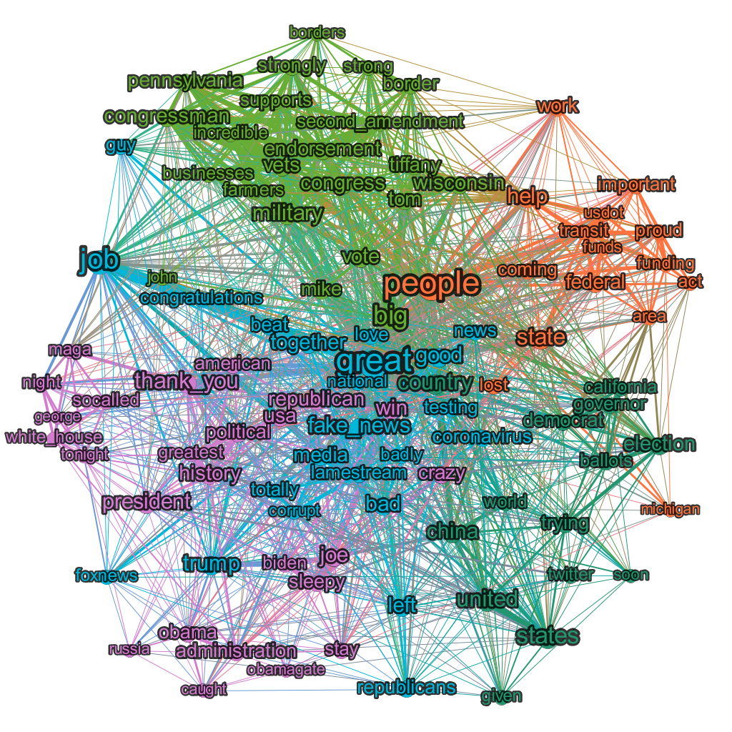
@realDonaldTrump May 2020
Potential Community Meanings
Orange
Transit funding
Lime green
Republican congressional primary endorsements
Dark green
Mail-in ballot fraud
He is mad at China now
Blue
COVID-19 response
Fake news
Pink
Riots
Political = bad (against him)
Obamagate (+ Sleepy Joe)
J
F
M
A
M
+

Slide 14
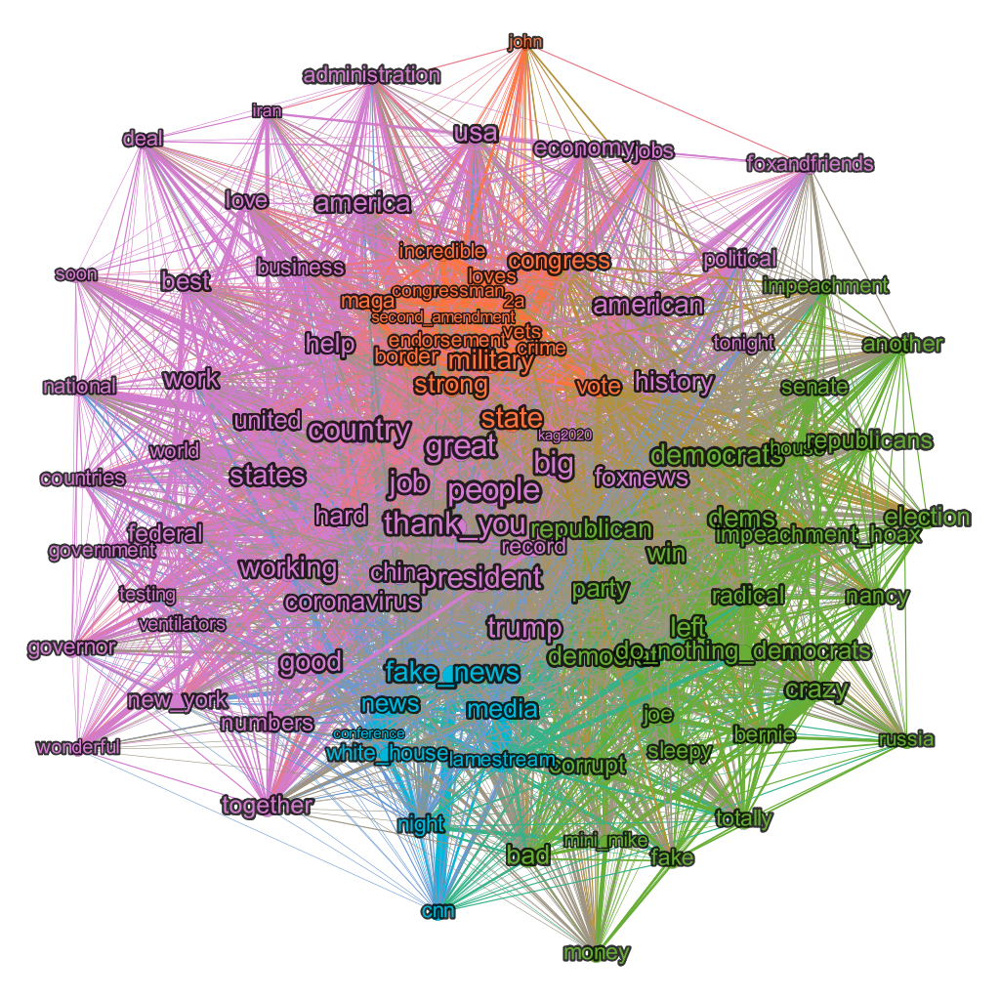
@realDonaldTrump May YTD 2020
Potential Community Meanings
Orange
Republican congressional primary endorsements
Lime green
Democrats
Blue
Fake News
Pink
COVID-19 and response
J
F
M
A
M
+

